Slide 1
Extension of Web Services (WS-*)
Service-Oriented Software Engineering
Software Institute
Nanjing University
Bei Jia

Slide 2
WS-*
WS-*
  All the Web services standards
  Or, extension Web services standards besides core-standards
Can we list all WS-*?
  Distinct among standard organizations or companies
  According to wiki, they are grouped as
XML Specification | Resource Specifications
Messaging Specification | Web Services Interoperability (WS-I) Specification
Metadata Exchange Specification | Transaction Specifications
Security Specification | Management Specifications
Privacy | Draft Specifications
Reliable Messaging Specifications | Other

Slide 3
WS-* list (1/3)
XML Specification
  XML
  XML Schema
  XPath
  XQuery
  XML Information Set
  XInclude
  XML Pointer
Messaging Specification
  SOAP (formerly known as Simple Object Access Protocol)
  SOAP-over-UDP
  SOAP Message Transmission Optimization Mechanism
  WS-Notification
    WS-BaseNotification
    WS-Topics
    WS-BrokeredNotification
  WS-Addressing
  WS-Transfer
  WS-Eventing
  WS-Enumeration
  WS-MakeConnection
Metadata Exchange Specification
  WS-Policy
  WS-PolicyAssertions
  WS-PolicyAttachment
  WS-Discovery
    WS-Inspection
  WS-MetadataExchange
  Universal Description, Discovery, and Integration (UDDI)
  WSDL 2.0 Core
  WSDL 2.0 SOAP Binding
    Web Services Semantics (WSDL-S)
  WS-Resource Framework (WSRF)
Privacy
  P3P
Reliable Messaging Specifications
  WS-ReliableMessaging
  WS-Reliability
  WS-RM Policy Assertion

Slide 4
WS-* list (2/3)
Security Specification
  WS-Security
  XML Signature
  XML Encryption
  XML Key Management (XKMS)
  WS-SecureConversation
  WS-SecurityPolicy
  WS-Trust
  WS-Federation
  WS-Federation Active Requestor Profile
  WS-Federation Passive Requestor Profile
  Web Services Security Kerberos Binding
  Web Single Sign-On Interoperability Profile
  Web Single Sign-On Metadata Exchange Protocol
  Security Assertion Markup Language (SAML)
  XACML
Resource Specifications
  Web Services Resource Framework
    WS-BaseFaults
    WS-ServiceGroup
    WS-ResourceProperties
    WS-ResourceLifetime
  WS-Transfer
  WS-Fragment
  Resource Representation SOAP Header Block
Web Services Interoperability (WS-I) Specification
  WS-I Basic Profile
  WS-I Basic Security Profile
  Simple Soap Binding Profile

Slide 5
WS-* list (3/3)
Business Process Specifications
  WS-BPEL
  WS-CDL
  Web Service Choreography Interface
  WS-Choreography
  XML Process Definition Language
Transaction Specifications
  WS-BusinessActivity
  WS-AtomicTransaction
  WS-Coordination
  WS-CAF
  WS-Transaction
  WS-Context
  WS-CF
  WS-TXM
Management Specifications
  WS-Management
  WS-Management Catalog
  WS-ResourceTransfer
  WSDM
Presentation Oriented Specification
  Web Services for Remote Portlets
Draft Specifications
  WS-Provisioning
Other
  Devices Profile for Web Services (DPWS)
  ebXML

Slide 6
Standards Organizations
 | W3C | OASIS | WS-I
Established | 1994 | 1993 as the SGML Open, 1998 as OASIS | 2002
Approximate membership | 400 | 600 | 200
Overall goal (as it relates to SOA) | To further the evolution of the Web, by providing fundamental standards that improve online business and information sharing. | To promote online trade and commerce via specialized Web services standards. | To foster standardized interoperability using Web services standards.
Prominent deliverables (related to SOA) | XML, XML Schema, XQuery, XML Encryption, XML Signature, XPath, XSLT, WSDL, SOAP, WS-CDL, WS-Addressing, Web Services Architecture | UDDI, ebXML, SAML, XACML, WS-BPEL, WS-Security | Basic Profile, Basic Security Profile

Slide 7
复合服务
为什么需要复合服务?
  有些服务是垂直的，有些服务是水平的。为保证复用性，某些垂直服务被设计为由水平服务构造而来
  如果活动由服务实现，那么由活动构成的（商业）流程由复合服务实现
  简单的说，复用&灵活
如何实现复合服务？
  一个可能的方法，在传统编程环境中，调用子服务，再把编程单元封装成服务以供调用
  采用标准协议的XML脚本描述服务组合方式

Slide 8
Modeling a Composite Web Service
To model a business process involves multiple parties, multiple Web services may be required to collaborate with each other to form a composite Web services
For example, a travel booking service may include:
  Flight reservation
  Hotel reservation
  Car reservation
They are logically individual and may be implemented by different providers

Slide 9
Recall: Orchestration 编排

Slide 10
Recall: Choreograph 编舞 编导

Slide 11
BPEL (1/3)
The Business Process Execution Language for Web Services (BPEL4WS, WS4BPEL, BPEL or WS-BPEL) is such a flow presentation developed to facilitate coordination of Web services into a comprehensive business process
Defines an interoperable integration model to facilitate the expansion of automated process integration in both intra-corporate and inter-corporate environments

Slide 12
BPEL (2/3)
A BPEL process defines how multiple business interactions are coordinated to achieve a common business goal with
  Status and
  Logic necessary for this coordination
Precisely define essential service behaviors for cross-enterprise business protocols, such as
  Data-dependent behaviors
  Exceptional conditions and their consequence
  Long-running interactions at various levels of granularity

Slide 13
BPEL (3/3)
Separates the public behaviors of a business process from its internal implements.
Two ways to model a business process
  An executable process model
    Model actual behaviors of the participates in a business interaction
  An abstract model
    Specifies the mutually visible message exchange behaviors of involved parties without revealing their internal behaviors
A two-phase procedure in order to create the business process in BPEL
  Create service descriptions
  Create business processes

Slide 14
BPEL的历史
WSFL（Web Services flow language）和XLANG， 2002 年，IBM、微软和BEA提出BPEL4WS 1.0
2003年，SAP和Siebel System等加入，BPEL4WS 1.1 向OASIS提交
2004年，从BPEL4WS 1.1 到WS-BPEL 2.0, （基本和WDSL 2.0 同时期），兼容WSDL 1.1
2007年，为考虑人的交互，补充规范BPEL4People和WS-HumanTask提出

Slide 15
A simple composite Web service

Slide 16
Create Service Descriptions (1/5)
Define the involved parties and the messages with WSDL (for payment and shipping provider)
<!-- portType supported by the payment service provider-->
< portType name="paymentPT">
<operation name="submitPayment“
pattern=" http://www.w3.org/ns/wsdl/in-out">
<input element="pos:paymentRequestMessage"/>
<output element="pos:paymentResponseMessage"/>
</operation>
</portType>
<!--portType supported by the shipping service provider-->
<portType name="shippingPT">
<operation name="requestShipping">
<input message="pos:shippingRequestMessage"/>
<output message="pos:shippingResponseMessage"/>
</operation>
</portType>

Slide 17
Create Service Descriptions (2/5)
Namespace for later reference
WSDL definitions for the supplier
<definitions targetNamespace="http://servicescomputing.org/wsdl/po"
xmlns:sns="http://servicescomputing.org/xsd/po"
xmlns:pos="http://servicescomputing.org/wsdl/po"
xmlns:xsd="http://www.w3.org/2001/XMLSchema"
xmlns="http://schema.xmlsoap.org/wsdl"
xmlns:plnk="http://schemas.xmlsoap.org/ws/2003/05/partner-link/">
<import namespace="http://servicescomputing.org/xsd/po"
location="http://servicescomputing.org/xsd/po.xsd"/>
……

Slide 18
Create Service Descriptions (3/5)
<!-- definitions of messages -->
<message name="PurchaseOrderMessage">
<part name="purchaseOrder" type="sns:purchaseOrder"/>
</message>
<message name="ResultMessage">
<part name="result" type="sns:Result"/>
</message>
<message name="shippingRequestMessage">
<part name="purchaseOrder" type="sns:purchaseOrder"/>
</message>
<message name="shippingResponseMessage">
<part name="shippingSchedule" type="sns:shippingSchedule"/>
</message>
<message name="paymentRequestMessage">
<part name="purchaseOrder" type="sns:purchaseOrder"/>
</message>
<message name="paymentResponseMessage">
<part name="paymentReceipt" type="sns:paymentReceipt"/>
</message>
Six types of messages

Slide 19
Create Service Descriptions (4/5)
<!-- portTypes supported by the supplier-->
<portType name="purchaseOrderPT">
<operation name="submitPurchaseOrder">
<input message="pos:PurchaseOrderMessage"/>
<output message="pos:ResultMessage"/>
</operation>
</portType>
The third portType

Slide 20
Create Service Descriptions (5/5)
<!--partner link types definitions-->
<plnk:partnerLinkType name="supplyLT">
<plnk:role name="purchaseOrderService">
<plnk:portType name="pos:purchaseOrderPT"/>
</plnk:role>
</plnk:partnerLinkType>
<plnk:partnerLinkType name="shippingLT">
<plnk:role name="shippingServiceReqestor">
<plnk:portType name="pos:shippingPT"/>
</plnk:role>
</plnk:partnerLinkType>
<plnk:partnerLinkType name="paymentLT">
<plnk:role name="paymentServiceReqestor">
<plnk:portType name="pos:paymentPT"/>
</plnk:role>
</plnk:partnerLinkType>
</definitions>
Represent the interaction or dependencies

Slide 21
Create Business Processes (1/4)
Process can be elaborated with the definitions of the portTypes, operations and message types

Slide 22
Create Business Processes (2/4)
<process name="orderService"
targetNamespace="http://servicecomputing.org/bpel4ws/purchase"
xmlns="http://schemas.xmlsoap.org/ws/2003/03/business-process/"
xmlns:lns="http://servicecomputing.org/wsdl/po">
<!--define partner links-->
<partnerLinks>
<partnerLink name="purchasing"
partnerLinkType="lns:supplyLT"
myRole="purchaseService"/>
<partnerLink name="payment"
partnerLinkType="lns:paymentLT"
myRole="paymentRequestor"
partnerRole="paymentServiceRequestor"/>
<partnerLink name="shipping"
partnerLinkType="lns:shippingLT"
myRole="shippingtRequestor"
partnerRole="shippingServiceRequestor"/>
</partnerLinks>
The namespace including WSDL
The role that the process play
The role that the partner play

Slide 23
Create Business Processes (3/4)
<!--define variables-->
<variables>
<variable name="PurchaseOrder" messageType="lns:PurchaseOrderMessage"/>
<variable name="Result" messageType="lns:ResultMessage"/>
<variable name="ShippingRequest" messageType="lns:shippingRequestMessage"/>
<variable name="ShippingResponse" messageType="lns:shippingResponseMessage"/>
<variable name="PaymentRequest" messageType="lns:paymentRequestMessage"/>
<variable name="PaymentResponset" messageType="lns:paymentResponseMessage"/>
</variables>
Types defined in WSDL
Variables are used to maintain state data and process history

Slide 24
Create Business Processes (4/4)
<!--define process-->
<sequence>
<receive partnerLink="purchasing"
portType="lns:purchaseOrderPT"
operation="submitPurchaseOrder"
variable="PurchaseOrder">
</receive>
<invoke partnerLink="payment"
portType="lns:paymentPT"
operation="submitPayment"
inputVariable="PaymentRequest"
outpurVariable="PaymentResponse">
</invoke>
<invoke partnerLink="shipping"
portType="lns:shippingPT"
operation="submitShipping"
inputVariable="ShippingRequest"
outpurVariable="ShippingtResponse">
</invoke>
<reply partnerLink="purchasing"
portType="lns:purchaseOrderPT"
operation="submitPurchaseOrder"
variable="Result"/>
</sequence>
</process>
variables processing maybe omitted

Slide 25
BPEL Key Elements (1/3)
partners
  Defines the relationship between a business process under construction and its partner processes.
  A partner can act as
    A consumer of a service provided by a business process
    A provider of a service that is used by a business process
    A service that activates a business process
partner link types
  Defines the conversational relationship between two Web services
  Defined in WSDL and give the role(s) linked to portType
partner links
  Models the partner services that a business process interacts with
  Is characterized by a partner link type
  Defines the static relationship within a business process

Slide 26
BPEL Key Elements (2/3)
business partners
  Model the relationship with a business partner who requires more that one conversational relationship, using element partner
  Allows the grouping of partner links
  Overlap is forbidden
endpoint references
  Provide a mechanism for dynamic binding with port-specific data for services.
  Allows dynamical binding of services provider with roles in partner links
activities
  Basic activities, such as receive, reply and invoke
  Structured activities
    Sequential order (sequence, switch and while)
    Concurrent order (flow)
    Non-deterministic choice (pick)
  Attributes, name, joinCondition, source, target

Slide 27
BPEL Key Elements (3/3)
data handling
  Models status in a business process
  Three way to handle
    Variables
    Expressions
    Assignments
  Provided for both XML data types and WSDL message types
Correlation
  Used to handle long-lasting stateful conversations between processes
  Used to identify new business process
Scope
  The context for the behavior of each activity
  Five kinds (fault handlers, event handlers, compensation handlers, data variables, and correlation sets)

Slide 28
Message Dispatch in Web Services
It is desirable for a message recipient to have the capability to uniquely identify the instance of Web services to handle it
Since it is not defined in WSDL, the provider are recommended to consider how to disambiguate message types when they develop their services
  In a typical deployment, an endpoint address may host a single service (described by a WSDL service element). When XSD is used, assigning unique qualified names of global element declarations as inputs within the interface that describes the service would be sufficient to disambiguate the types of the messages that are received
  When endpoint address hosts multiple services, in essence supporting several WSDL descriptions, the desire to disambiguate message types should be considered within the context of all the deployed services, not only within a single interface
If the provider can’t achieve the above goals, especially, wildcards are used (#any, #none), disambiguation mechanisms are necessary.
It is also need to identify instance of stateful Web services

Slide 29
WS-Addressing
The WS-Addressing specification provides such a disambiguation mechanism.
It consists of an extension element which may be marked as required, and defines a required action property whose value is always present in a conformant message delivery.
The value of the action property can be used to disambiguate the message by the receiver and there is a well defined way to associate actions to messages in WS-Addressing specifications
Further, WS-Addressing also provides an appropriate default action value that identifies each message type uniquely
WS-Addressing defines
  Endpoint reference and
  SOAP header blocks

Slide 30
SOAP message with WS-Addressing
<soap:Envelope xmlns:soap="http://www.w3.org/2003/05/soap-envelope" xmlns:wsa="http://www.w3.org/2004/12/addressing">
<soap:Header>
<wsa:MessageID>uuid:SomeUniqueMessageIDString</wsa:MessageID>
<wsa:ReplyTo>
<!-- Endpoint reference for intended receiver of message reply -->
<wsa:Address>http://myclinet.com/business/someClinet</wsa:Address>
</wsa:ReplyTo>
<!-- Endpoint reference for ultimate receiver of message reply -->
<wsa:To>http://www.plastics_supply.com/purchasing</wsa:To>
<wsa:Action>http://www.plastics_supply.com/SubmitPO</wsa:Action>
</soap:Header>
<soap:Body>
<!-- the message body of the SOAP request appears here -->
<SubmitPO>…</SubmitPO>
</soap:Body>
</soap:Envelope>
From, FaultTo, RelatesTo blocks can also be defined

Slide 31
Endpoint Reference
<wsa:EndpointReference xmlns:wsa="http://schema.xmlsoap.org/ws/2003/03/addressing" xmlns:wsp="http://schema.xmlsoap.org/ws/2004/09/policy" xmlns:tns="http://supply.com/PurchaseService/wsdl">
<wsa:Address>http://supply.com/PurchaseService/wsdl</wsa:Address>
<wsa:PortType>tns:PurchaseOrderPortType</wsa:PortType>
<wsa:ServiceName PortName="tns:PurchaseOrderPort">tns:PurchaseOrderService
</wsa:ServiceName>
<wsa:ReferenceProperties>
<tns:CustomerServiceLevel>
Premium
</tns:CustomerServiceLevel>
</wsa:ReferenceProperties>
<wsp:Policy>
<!-- policy statement omitted-->
</wsp:Policy>
</wsa:EndpointReference>
It defines a resource with this message exchange

Slide 32
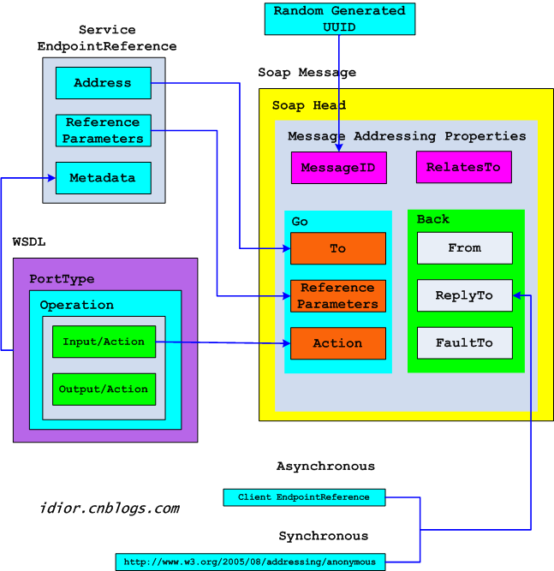
Request Message

Slide 33
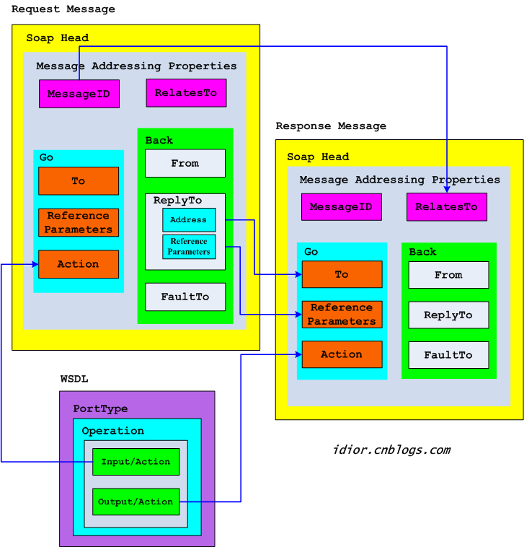
Response Message

Slide 34
Stateless and Stateful Web services (1/4)
Stateless web services don’t capture or maintain state
  Web services without context
Stateful web services
  Serve various types of consumers and provide personalized services
  Persistent information to serve consumers better
  Comprehensive services require collaboration

Slide 35
Stateless and Stateful Web services (2/4)
Stateless services
  scale better and are more fault-tolerate
  Lightweight
Stateful services
  Support more comprehensive business transactions and provide more personalized services
  Requires more coding and additional processing resources
  Heavyweight

Slide 36
Stateless and Stateful Web services (3/4)

Slide 37
Stateless and Stateful Web services (4/4)

Slide 38
Stateful Web services Modeling
Web Services Resource Framework (WSRF)
  Defines a system of specifications for managing and accessing stateful resources using Web services
  Contains four sets of specifications to access to internal status of a resource via web service interfaces:
    WS-ResourceProperties
    WS-ResourceLifetime
    WS-BaseFault
    WS-ServiceGroup
  Support dynamic creation of resource properties and associated values

Slide 39
WS-Resource Lifetime
WS-Resource Lifetime specification defines message exchanges to standardize the means as to how a WS-Resource can be destroyed, and how resource properties can be used to inspect and monitor the lifetime of a WS-Resource.
It defines two means of destroying a WS-Resource:
  Immediate destruction
  Time-based scheduled destruction

Slide 40
An sample stateful resource definition (1/3)
<xs:schema targetNamespace="http://servicescomputing.org/SampleStatefulResource" xmlns:tns="http://servicescomputing.org/SampleStatefuleResource" xmlns:xs="http://www.w3.org/2001/XMLSchema">
<xs:elements>
<xs:element name="name" type="xsd:string"/>
<xs:element name="leftNumberInStorage" type="xsd:string"/>
<xs:element name="SampleStatefulResource">
<xs:complexType>
<xs:sequence>
<xs:element ref="tns:name"/>
<xs:element ref="tns:leftNumberInStorage"/>
</xs:sequence>
</xs:complexType>
</xs:element>
</xs:elements>
……
</xs:schema>
WS-Resource properties type definition

Slide 41
An sample stateful resource definition (2/3)
<!--Association of resource properties document to a portType-->
<wsdl:definations
targetNamespace="http://servicescomputing.org/SampleStatefulResource"
xmlns:wsdl="http://schemas.xmlsoap.org/wsdl/"
xmlns:xs="http://www.w3.org/2001/XMLSchema"
xmlns:wsrp="http://www.ibm.com/xmlns/stdwip/web-services/ws-resourceProperties"
xmlns:tns="http://servicescomputing.org/SampleStatefulResource">
……
<wsdl:types>
<xs:schema>
<xs:import namespace="http://servicescomputing.org/SampleStatefulResource"
schemalocation="..."/>
</xs:schema>
</wsdl:types>
……

Slide 42
An sample stateful resource definition (3/3)
<wsdl:portType name="ProductPrice"
wsrp:resourceProperties="tns:SampleStatefulResource">
<operation name="getPrice"/>
……
</wsdl:portType>
……
</wsdl:definations>
Link WS-Resource properties to portType

Slide 43
The QoS of Web Service
Four categories of QoS standards have arisen
  Security
  Transaction
  Reliable messaging
  Resource lifetime management

Slide 44
WS-Security (1/2)
The problems of BASIC-Auth and HTTPS
Ensured by BASIC-Auth and HTTPS

Slide 45
WS-Security (2/2)
Web Service Security provides a set of mechanisms to help Web service developers secure SOAP message exchanges
It is a family of protocols that enhances the messaging technique to solve three basic problems about the quality of protection of Web services
  Authentication and authorization of users
  Message integrity
  Message encryption

Slide 46
WS-Security road map

Slide 47
Models in road map (1/2)
WS-Policy provides a syntax-wired model to specify Web service endpoint policies, and it is further refined by including
  WS-Security Policy defines a grammar for expressing Web service policies. It is a language to support the WS-Security specifications
  WS-Policy Framework is defined to allow extensibility to express generic policies not limited to security policies. It intends to accommodate expressions of domain-specific policy languages within a consistent Web services framework
  WS-Policy-Attachment offers ways to advertise policy assertions with Web services. It builds on the existing WSDL and UDDI specifications and also supports extensibility
  WS-Policy-Assertions language offers common policy expressions, which define a generic set of policy assertions for Web Services

Slide 48
Models in road map (2/2)
WS-Trust defines methods to request and issue security tokens for establishing trust relationships
WS-Privacy specification describes a model for expressing privacy claims inside of WS-Policy descriptions and associating privacy claims with messages
WS-Authorization defines how Web services manage authorization data and policies
WS-SecureConversation defines a security context based on security tokens for secure communications
WS-Federation defines mechanisms to enable federation of identify, account, attribute, authentication, and authorization across different trust realms. Pseudonym model is supported in WS-Federation

Slide 49
Structure of WS-Security SOAP message

Slide 50
加入身份验证的SOAP消息
<?xml version="1.0" encoding="UTF-8"?>
<s:Envelope xmlns:s="http://schemas.xmlsoap.org/soap/envelope" xmlns:wsse="http://schemas.xmlsoap.org/ws/2002/12/secext">
<s:Header>
<wsse:Security>
<!--用户名和密码-->
<wsse:UsernameToken>
<wsse:Username>happyyu</wsse:Username>
<wsse:Password>cabbage</wsse:Password>
</wsse:UsernameToken>
</wsse:Security>
</s:Header>
……
</s:Envelope>
Encrypted in transport layer

Slide 51
加入安全证书的SOAP消息
<?xml version="1.0" encoding="UTF-8"?>
<s:Envelope xmlns:s="http://schemas.xmlsoap.org/soap/envelope" xmlns:wsse="http://schemas.xmlsoap.org/ws/2002/12/secext">
<s:Header>
<wsse:Security>
<!--Kerberos 安全证书声明-->
<wsse:BinarySecurityToken ValueType="wsse:Kerberosv5ST" EncodingType="wsse:Base64Binary">
XSETt...
</wsse:BinarySecurityToken>
</wsse:Security>
</s:Header>
</s:Envelope>

Slide 52
加入数字签名的SOAP消息
<s:Envelope xmlns:s="http://schemas.xmlsoap.org/soap/envelope" xmlns:wsse="http://schemas.xmlsoap.org/ws/2002/12/secext">
<s:Header>
<wsse:Security>
<!--X.509 安全证书凭证声明-->
<wsse:BinarySecurityToken ValueType=" wsse:X509v3" wsu:Id="X509Cert" EncodingType="wsse:Base64Binary">
XSETt...
</wsse:BinarySecurityToken>
<!--数字签名声明-->
<ds:Signature xmlns="http://www.w3.org/2000/09/xmldsig#">
<ds:SignedInfo>
<ds:CanonicalizationMethod Algorithm="http://www.w3.org/2000/10/xml-3xc-c14N"/>
<ds:SignatureMethod Algorithm="http://www.w3.org/2000/09/xmldsig#rsa-shal"/>
<ds:Reference URI="MessageBody">
<ds:DigestValue> ... </ds:DigestValue>
</ds:Reference>
<ds:SignedValue>
...
</ds:SignedValue>
<ds:keylnfo>... </ds:keylnfo>
</ds:SignedInfo>
</ds:Signature>
</wsse:Security>
</s:Header>
<s:Body wsu:Id="Message Body">
...
</s:Body>
</s:Envelope>

Slide 53
加密的SOAP消息
<s:Envelope xmlns:s="http://schemas.xmlsoap.org/soap/envelope" xmlns:wsse="http://schemas.xmlsoap.org/ws/2002/12/secext" xmlns:wsu="http://schemas.xmlsoap.org/ws/2002/07/utility"
xmlns:ds="http://www.w3.org/2002/09/xmldsig#" xmlns:xenc="http://www.w3.org/2002/09/xmlenc#">
<s:Header>
<wsse:Security>
<!--加密方法声明-->
<xenc:EncryptedKey>
<xenc:EncryptionMethod Algorithm="http://www.w3.org/2001/04/xmlenc#rsa-l_5"/>
<ds:Keylnfo>
<ds:KeyName> CN=Key13,C=US </ds:KeyName>
</ds:Keylnfo>
<xenc:CipherData>
<xenc:CipherValue> fds7#rt... </xenc:CipherValue>
</xenc:CipherData>
<xenc:ReferenceList>
<xenc:DataReference URI="#EncryptcdMessageBody"/>
</xenc:ReferenceList>
</xenc:EncryptedKey>
</wsse:Security>
</s:Header>
<s:Body>
<!--加密声明-->
<xenc:EncryptedData wsu="EncryptedMessageBody">
<xenc:EncryptionMethod Algorithm="http://www.w3.org/2001/04/xmlenc#triplededs-cbc"/>
<xenc:CipherData>
<xenc:CipherValues> GDSW#df </xenc:CipherValues>
</xenc:CipherData>
</xenc:EncryptedData>
</s:Body>
</s:Envelope>

Slide 54
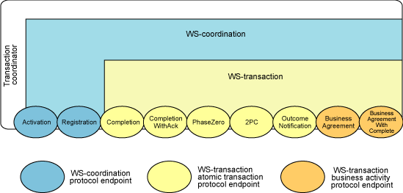
WS-Coordination
WS-Coordination is a general mechanism for starting and coordinating the outcome of multiparty multi-message Web services
It defines a coordinator service and a coordination context
It is a framework for coordinating Web services interactions

Slide 55
The Coordination Framework
Coordinator service provides a service, described in WSDL, which has the ability of starting a coordinated task, terminating a coordinated task, allowing a participant to register in a task, and producing a coordination context within a group
  Activation Service to create an activity
  Registration Service to coordinate protocol selection and register participants
  Coordination Service for activity completion processing
It also includes an interface in WSDL, which the other participating services could use to be notified of the outcome of a coordinated task

Slide 56
Coordination context
Coordination context supports all messages that Web services exchange during a conversation
It contains a WS-Addressing endpoint reference to the coordination service, which in turn contain information to identify the specific task being coordinated

Slide 57
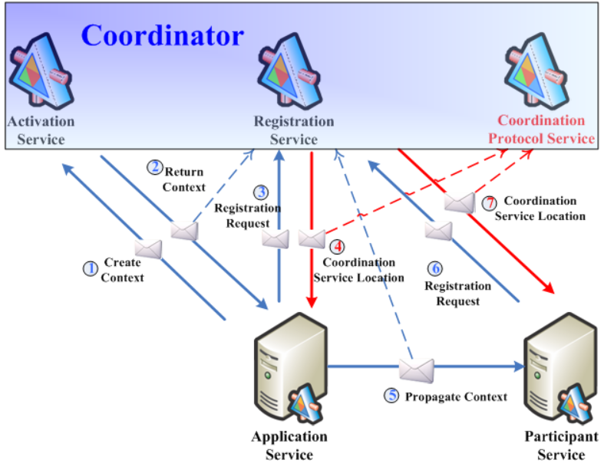
Coordination Process

Slide 58
The Coordination Type (1/2)
An atomic transaction (AT) is used to coordinate activities having a short duration and executed within limited trust domains.
  AT have an "all or nothing" property
  The AT specification defines protocols that enable existing transaction processing systems to wrap their proprietary protocols and interoperate across different hardware and software vendors
A business activity (BA) is used to coordinate activities that are long in duration and desire to apply business logic to handle business exceptions
  The long duration prohibits locking data resources to make actions tentative and hidden from other applications. Instead, actions are applied immediately and are permanent
  The BA specification defines protocols that enable existing business process and work flow systems to wrap their proprietary mechanisms and interoperate across trust boundaries and different vendor implementations

Slide 59
The Coordination Type (2/2)
Protocols for Atomic Transactions
Protocols for Business Transactions
执行事务操作
2
（
失败
），
执行操作
1
的补偿操作
执行事务操作
1
有效状态
2
（
成功
）
执行事务操作
2
（
成功
）
有效状态
1
（
不允许作为
有效状态
3
最终状态
）

Slide 60
WS-Atomic Transaction (WSAT)
WSAT defines short duration, ACID transactions
  Atomicity: If successful, then all the operations happen, and if unsuccessful, then none of the operations happen
  Consistency: The application performs valid state transitions at completion.
  Isolation: The effects of the operations are not shared outside the transaction until it completes successfully
  Durability: Once a transaction successfully completes, the changes survive failure
It provides the definition of the atomic transaction coordination type to be used with the extensible coordination framework described in the WS-Coordination specification
The specification defines specific agreement coordination protocols for the atomic transaction coordination type:
  Completion
  CompletionWithAck
  2PC (Durable2PC)
  PhaseZero (Volatile2PC)
  OutcomeNotification

Slide 61
WS-Business Activity (WSBA)
WSBA defines longer running business transactions
The specification defines two specific agreement coordination protocols for the business activity coordination type:
  BusinessAgreementWithParticipantCompletion
  BusinessAgreementWithCoordinatorCompletion
Developers can use any or all of these protocols when building applications that require consistent agreement on the outcome of long-running distributed activities

Slide 62
WS-Reliable Messaging (1/2)
Web service Reliability is a SOAP-based protocol designed to ensure reliable message exchanges
  With guaranteed delivery
  Without duplications
  Assured message ordering
WS-Reliability is defined as SOAP header extensions and extends the SOAP Fault Specifications with fault codes to specify reliable messaging-specific fault values

Slide 63
WS-Reliable Messaging (2/2)
Guaranteed delivery
  A reliable messaging model is put forward, in which A sender sends a SOAP message with a globally unique identifier to a receiver directly and the receiver sends back an acknowledging SOAP message to the sender.
  If the sender does not receive an acknowledge message, it attempts to resend the SOAP message
Duplication-free and message ordering insurance
  Use the identifier in SOAP message to eliminated duplicated message, and reordering messages.

Slide 64
Read More…
题名/责任者:Services computing = 服务计算 / Liang-Jie Zhang, Jia Zhang, Hong Cai.
出版发行项:Beijing : Tsinghua University Press ; Berlin ; New York : Springer, c2007.
ISBN:9787302150756 (Tsinghua University Press)
ISBN:9783540382812 (Springer)
URL: http://202.119.47.8:8080/opac/item.php?marc_no=0003334218
List of web service specifications
URL:http://en.wikipedia.org/wiki/List_of_web_service_specifications
idior’s blog
URL: http://idior.cnblogs.com/

